Slide 1

Library management System
-Venkatesh

Slide 2
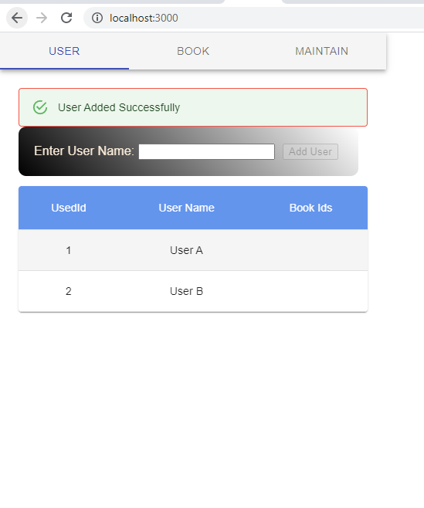
Add User

Slide 3
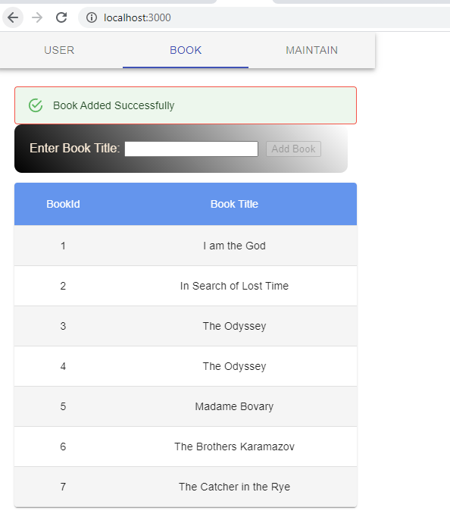
Add Book

Slide 4
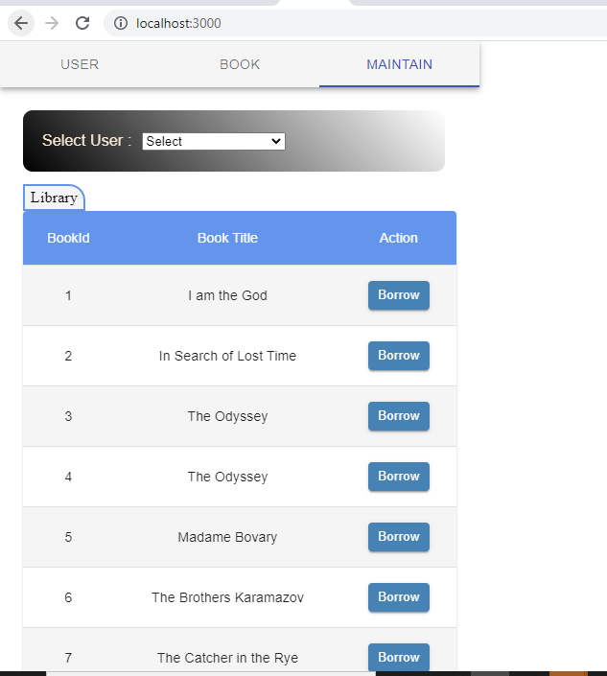
Library Books

Slide 5
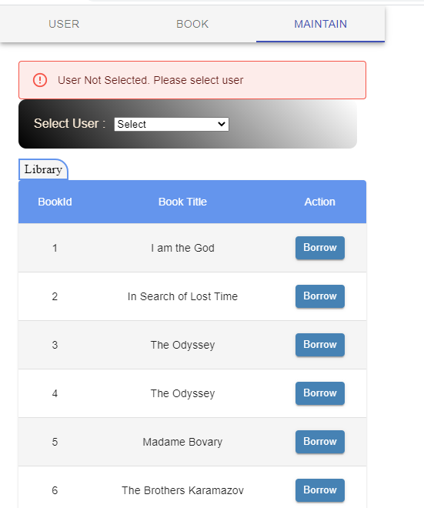
Borrow book -when user not selected

Slide 6
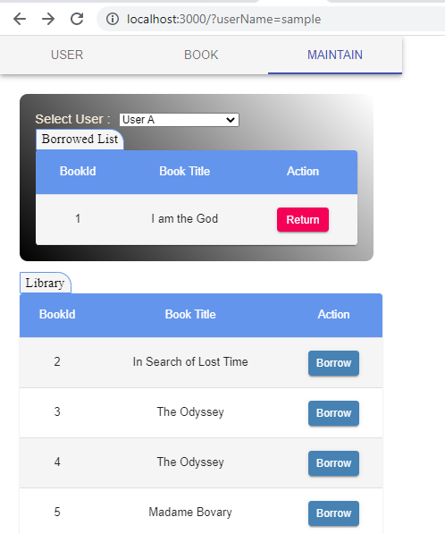
Borrowed List

Slide 7
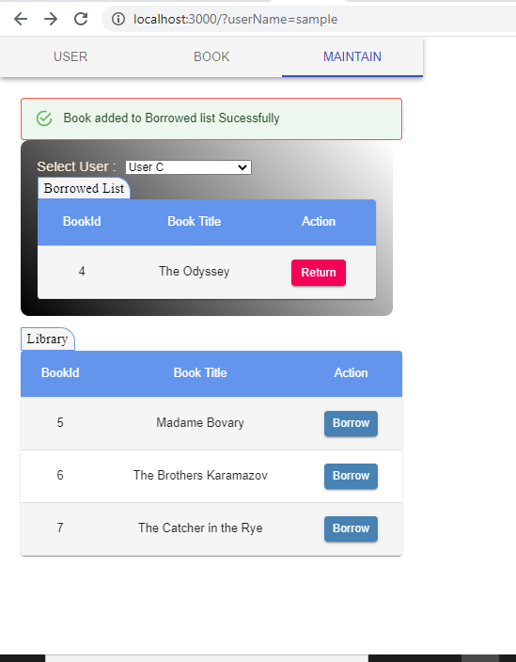
Borrow book

Slide 8
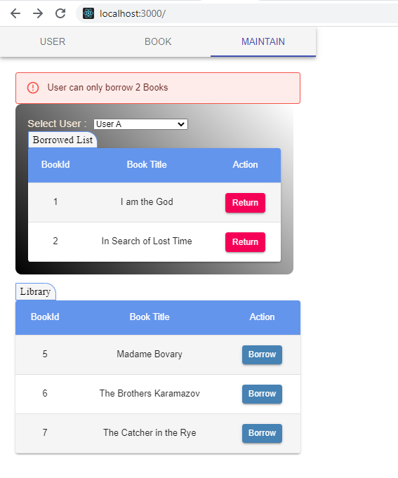
Borrow book -when user exceeds limit

Slide 9
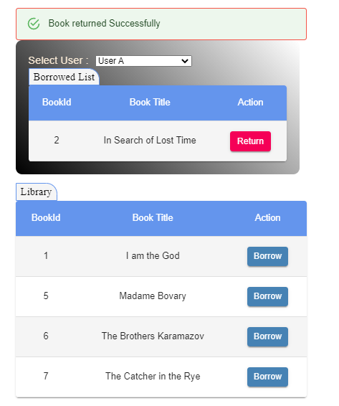
Return Book

Slide 10
Instructions to run application
React
Clone application from git – https://github.com/durgaVenkatesh27/library-app-react
CD Library-app
Run “npm i”
Run “npm run build”
Run “npm start”
Spring
Clone application from git – https://github.com/durgaVenkatesh27/library-app
CD Library-app
Run application
Go
Now go to http://localhost:3000/

